Slide 1
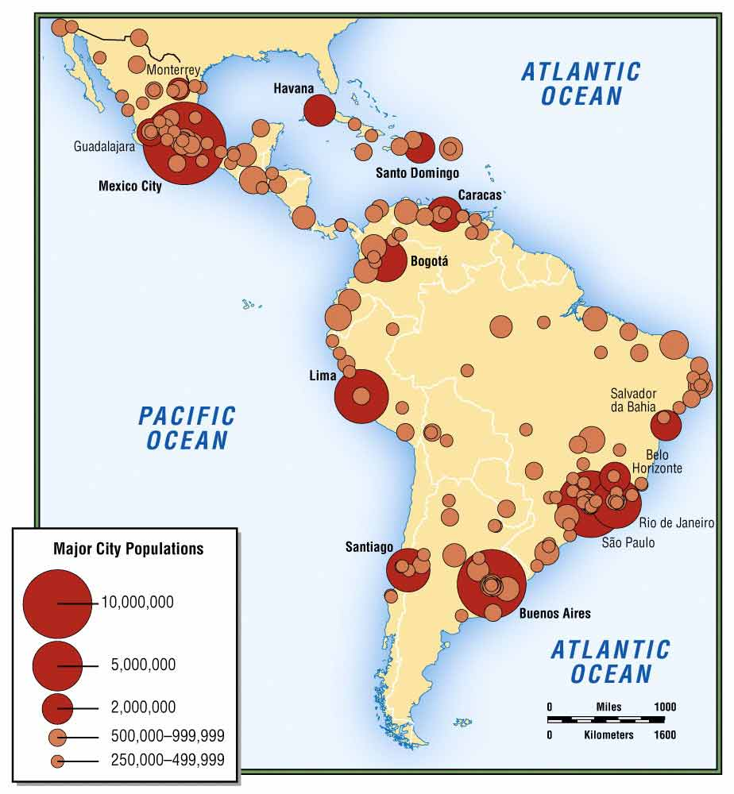
Document 1- Population Density
What are four cities with large populations in Latin America?
What do you notice about the location of the cities with the largest populations?

Slide 2
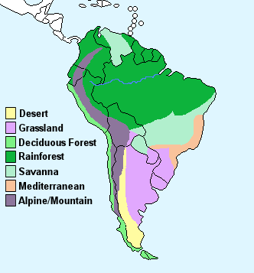
DOCUMENT 2- Climate
What are the different climate types of South America?
Use the map to explain the climate of Argentina
What landform would explain the Alpine/Mountain climate?

Slide 3
DOCUMENT 3- Fertility Rate
What is the fertility rate in Colombia?
What is the fertility rate in Brazil?
Which country has the lowest fertility rate in Latin America?
Would you say the fertility rate is high or low overall? Why?

Slide 4
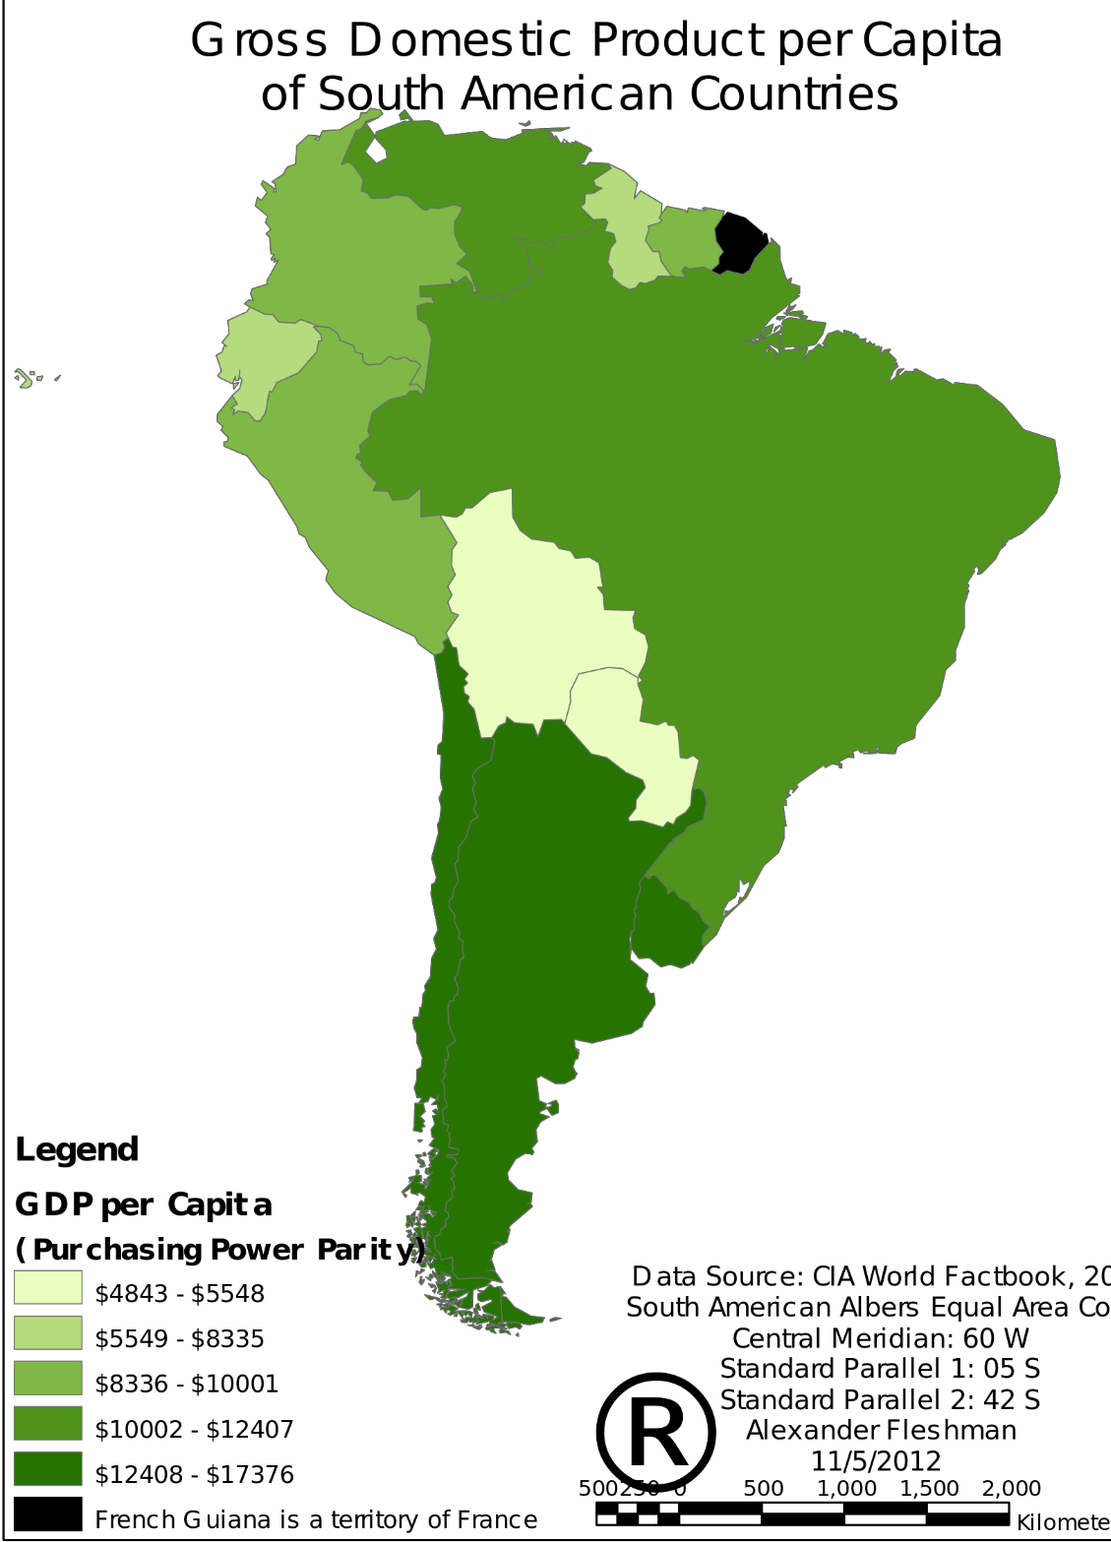
DOCUMENT 4- Per Capita GDP
Which South American countries are richer?
Which South American countries are poorer?
What do you notice about the location of the
richest countries in South America?

Slide 5
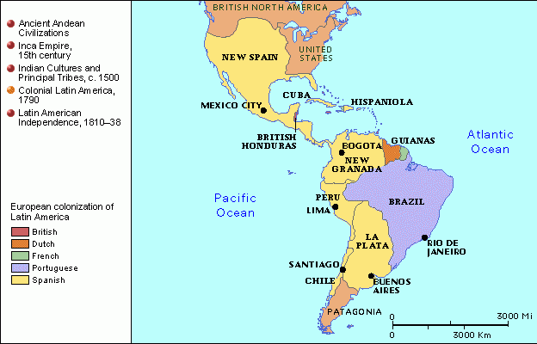
DOCUMENT 5- Colonization and Empires
Which European country controlled the most land in Latin America?
What country controlled Brazil?
How might Brazil’s culture be influenced by colonization?

Slide 6
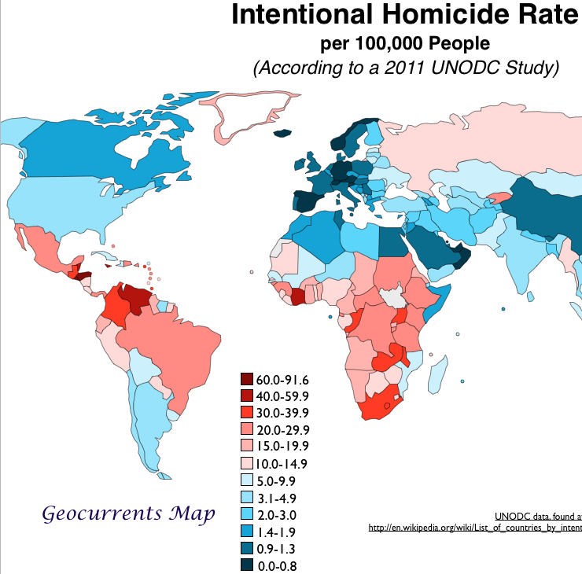
DOCUMENT 6- Homicide Rate
Which Latin American country has the highest homicide rate?
Which countries in Latin America have low homicide rates?
Why do you think a country like Argentina would have a low homicide rate?

Slide 7
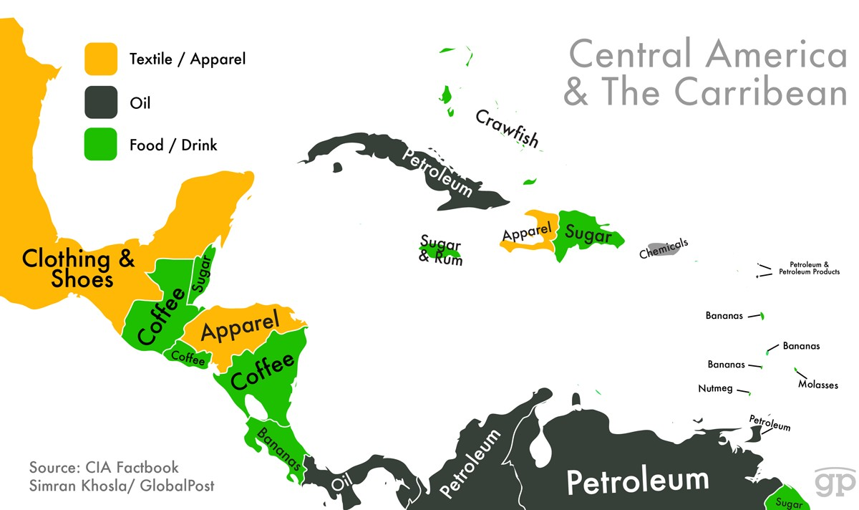
DOCUMENT 7- Exports
Identify the countries where food/drink is the most valued export?
What is an export?
What is a textile?
What is the most valued export from the Dominican Republic?

Slide 8
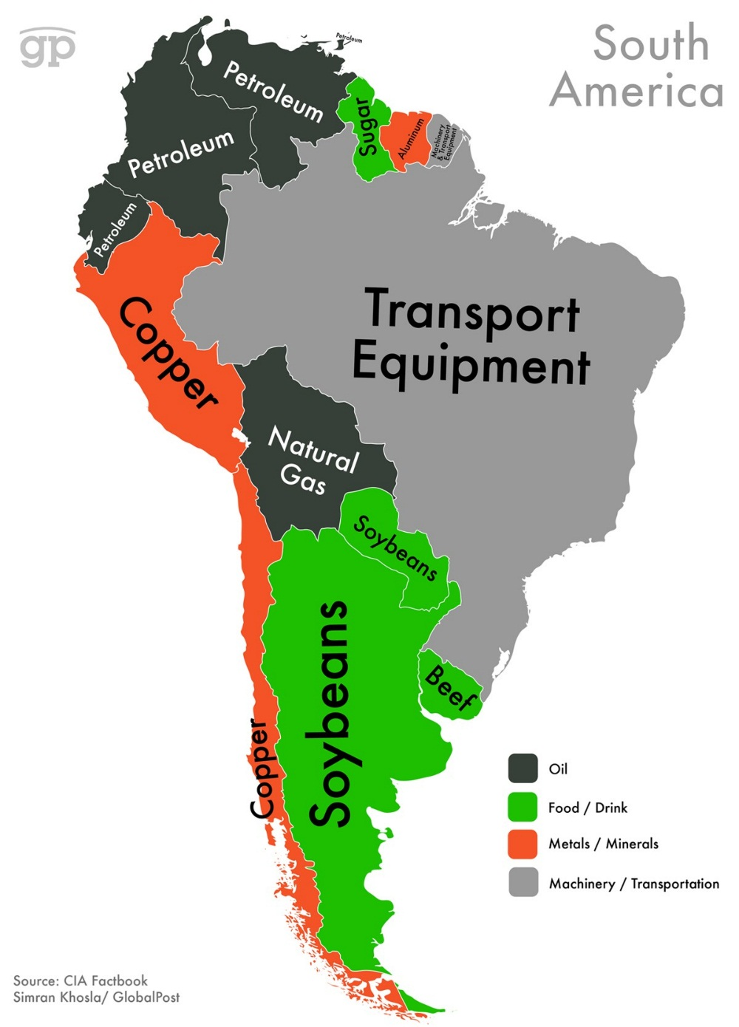
DOCUMENT 8- Exports
What do Venezuela, Colombia, and Ecuador have in common?
What do you notice about the most valued exports of South America?
Compare and contrast the valued exports of South America with the valued exports of Central America and the Caribbean.

Slide 9
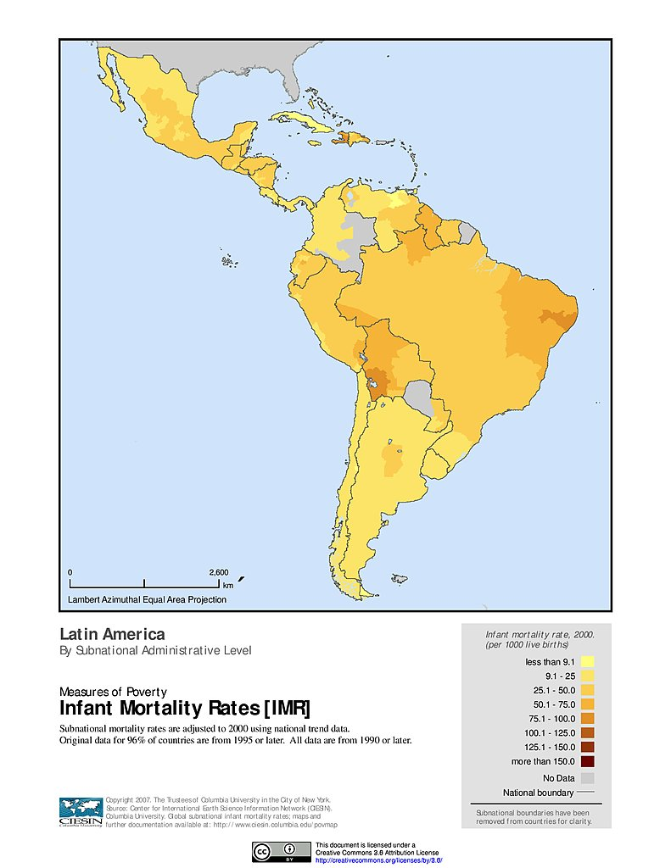
DOCUMENT 9- Infant Mortality Rates
What are two countries with low infant mortality rates?
What is a country with a high infant mortality rate?
What do you notice about infant mortality rates in South America?

